Slide 1
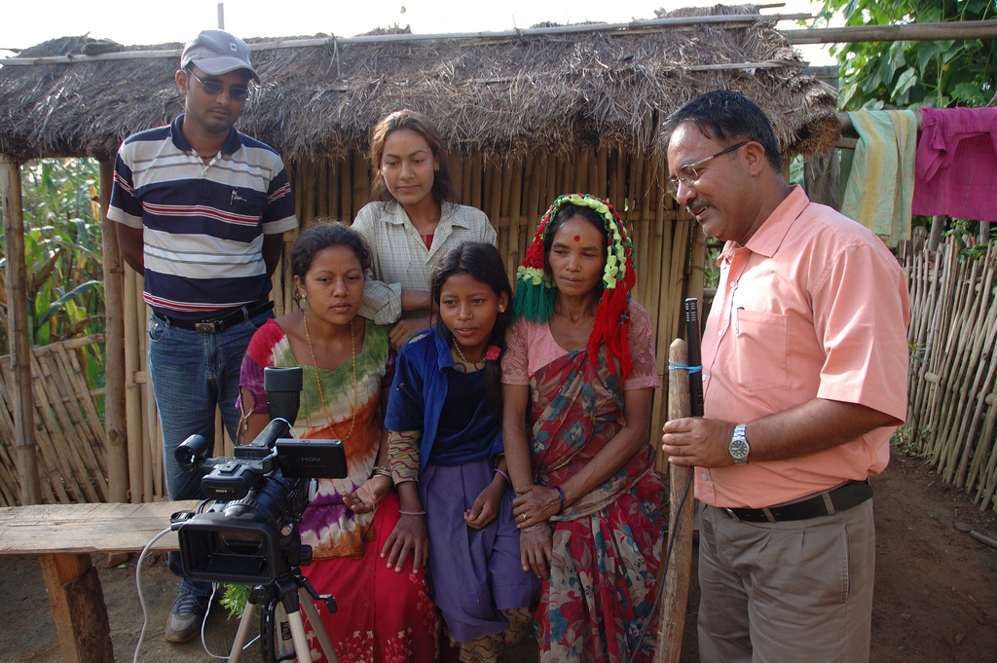

Research Methods in Social Psychology
[Professor Name]
[Class and Section Number]
Notes:
Classroom Recommendations: This material could be covered in one 50 to 75-minute class period. It is intended to present overview topics in social psychology research. Some of these topics will have been presented to students in other courses such as Introduction to Psychology and Research Methods. Therefore, an effort should be made to focus especially on the aspects of these methods that are unique to social psychology or represent variations of how they might be applied in other areas of psychology. Please refer to the Lecture Framework in the Noba Instructor Manual for specific details.
Overview: The Research Methods in Social Psychology module introduces students to basic definitions, concepts, and empirical methodology used in the social psychology research. This PowerPoint presentation provides material which includes content, activities, and a video to help you craft a class lesson for your students to help keep them interested and engaged in this material.
Special Instructions: You may choose to begin by having students write a 3-5 sentence summary of the module content. This should, of course, only be done if the reading was assigned prior to the class session. You may also choose to have students generate questions from the reading related to material they found confusing or interesting. For a more involved warm up activity, see the following slide.
Technical Note: These slides may contain simple click animation so that you can focus students’ attention on a particular question, a selection of text, or an image and not have them be distracted by reading ahead. You can either preview the sequence of animation by going through the slides in slideshow view, visiting the animations tab, or reviewing the slide notes. In the notes you will see a cue - (Click) – that corresponds to each animation.
You may also find hyperlinks to outside videos at various places in the slides. These hyperlinks are embedded in text and indicated by color and in the notes section.

Slide 2
Learning Objectives
1. Explain the role of observation in research.
2. List 3 principles of ethical research.
3. Name 3 approaches to studying social phenomenon.
4. Explain the advantages and disadvantages of each of these approaches.
Notes:
This slide outlines the learning objectives of the module.

Slide 3

Warmup Activity: Consider Your Research
Imagine you are a social psychologist. Imagine you wanted to study “flirting.” How would you do it?
Notes:
The purpose of this slide is to facilitate an activity to get students thinking about the concept of research and empirical observation of a social psychological phenomenon.
Activity (15 minutes): Begin by having them reflect silently about the prompt on screen and write down notes on a piece of paper. After this period of reflection you can shift to small group discussions. Discussion should then shift to the larger class so that students can share their ideas more widely. The purpose of this activity is to get students to think about definitions, hypotheses, methods of measurement, and ethical considerations. Although this activity can take a large amount of class time it is also engaging and can be used to cover a large amount of class content. These are points that you can underscore during the large class debriefing:
-- Hypotheses: Students may mention certain groups (observing unmarried people in a bar or surveying teens in high school). This is an opportunity to point out the sometimes concealed hypotheses (in these examples that it is young people, or unmarried people who are more likely to flirt). Ask your students where their hypotheses originate.
-- Operationalizing/Measurement: Students might mention specific flirting behaviors or specific methods (observation, checklists, surveys, peer report). This is an opportunity for you to point out that all researchers make decisions about which measures might be the best and that there are always limitations to each method. This is why, of course, we use multiple methods and multiple studies to create a tapestry of findings that point toward a more confident conclusion.
-- Ethics: Students may mention natural observation (eg. Observing teens interact at a shopping mall) and this is a great opportunity to explore with the students if they think this would be ethical and under what conditions such observation might not be.

Slide 4
Overview
How do scientists think?
Observation
Hypothesis
Research issues
Measurement
Ethics
WEIRD samples
Types of research
Laboratory
Field
Survey
Nonconscious
Archival
Wrap-up
Notes:
The purpose of this slide is to provide students with an overview of the material that will be covered during each portion of the lecture

Slide 5

How do Scientists Think?
Observation
Notes:
Here, the instructor introduces the idea that scientists in general, and social psychology researchers specifically, have a unique approach to thinking. At its heart scientific thinking is curious and exploratory. Scientists are intrigued by questions. Many people think that scientists are primarily focused on finding answers but this is not entirely true: they love musing, wondering, and what ifs. The first of two “”think like a scientist” points is “generating hypotheses”. See below:
Generating Hypotheses: Scientists are on the prowl! They are constantly vigilant for interesting social phenomenon. Examples include: unusual behavior (the way an author talks about a character as if it is a separate person with a separate identity), interesting behavior (some people but not others say “thank you” to bus drivers when getting off the bus), confusing behavior (some people’s personalities change dramatically when they are in 1 on 1 interactions versus when they are interacting in large groups). Scientists notice these behaviors in real life, but also in their reading of previously published research, on TV, in books, and other works. Point out to students that this habit of observation becomes the foundation of research questions.
Optional class activity: Have students consider their own lives. Direct them to think about their relationships, about their activities, about their work and school lives, about their sense of identity. Using small groups, have them share interesting observations about curious phenomena. These could include patterns of speech, non-verbal behavior, competition, school culture or almost any social topic. In small groups have them generate a few hypotheses about the most intriguing observation offered.

Slide 6
Overview
How do scientists think?
Observation
Hypothesis
Research issues
Measurement
Ethics
WEIRD samples
Types of research
Laboratory
Field
Survey
Nonconscious
Archival
Wrap-up
Notes:
The purpose of this slide is to provide students with an overview of the material that will be covered during each portion of the lecture

Slide 7

Research Issues
Measurement
Ethics
WEIRD Samples
Notes:
Here, instructors highlight a number of important issues related to social psychology research.
Measurement: Once a researcher has identified a hypothesis they have to determine a way to measure it. This means creating very specific definitions or the phenomenon they wish to investigate. Possible discussion questions:
--Imagine you wanted to research the effects of mobile phone use on the quality of romantic relationships. You would have to define “mobile phone use” as well as “romantic relationships” and also provide measures of “quality”. How would you define these terms in a way that can be measured?
Ethics: Ethics are important to protect participants from physical or psychological harm. This is particularly true in social psychology where experience sampling can intrude on daily life, naturalistic observation is a threat to privacy, and deception is used. You may choose to use clickers or raised hands to discover how many students know what an IRB is or about the ethics review process for research. Possible discussion question:
-- At University A there is an Institutional Review Board (IRB) that meets regularly to review research proposals. The board includes doctoral level researchers from several fields. They read and discuss applications and either suggest revisions, deny the research, or approve the research. Applications ask the research to identify potential harm and the potential benefit of the study and to identify the specific participant group and measurement techniques used. The approval is for a set period of time and must be renewed on a regular basis. What are your reactions to this process? How might you improve this process?
WEIRD samples: For years psychologists have relied heavily on convenience samples. Specifically, they have employed university students as research participants. This has led some critics to wonder about the generalizability of study results. WEIRD stands for “Western, educated, industrialized, rich, democratic.” This suggests that some societies and cultures (eg. Middle Eastern cultures) are underrepresented in psychological research. This is not to say that there have been NO studies on frequently overlooked groups. Possible discussion questions:
-- Study A finds that 18-24-year-olds at a university in Vancouver, Canada place a heavier emphasis on “meaning at work” than do 55-62-year-olds. How should we interpret these results and what can be done to mitigate WEIRD bias in future research?
Note: This is an opportunity to stress that these topics are viewed as values-neutral, exploratory topics rather than political in nature. Some students will see cultural differences as a fundamentally political idea (eg. Is it racist or insensitive to draw similarities between Chinese and Japanese people?).

Slide 8
Overview
How do scientists think?
Observation
Hypothesis
Research issues
Measurement
Ethics
WEIRD samples
Types of research
Laboratory
Field
Survey
Nonconscious
Archival
Wrap-up
Notes:
The purpose of this slide is to provide students with an overview of the material that will be covered during each portion of the lecture

Slide 9

Laboratory
Artificial environment allows researchers to control conditions and variables.
Can determine causal direction; how one variable might causally influence another.
Notes:
In this, you can present the first of 5 common research paradigms. The laboratory experiment is, perhaps, the oldest and most prototypical way to conduct research. It comes to psychology from medicine and physiology studies. A laboratory is an artificial and controlled environment. Lab studies help us control variables and establish causality. Because of their artificial environment, however, their results do not necessarily generalize to real world behaviors.
One easy way for students to understand this concept is to compare the laboratory to the classroom environment. The classroom is, in many ways, an artificial and controlled environment meant to promote learning. You can engage the students in thinking like scientists by suggesting they consider an investigation of how the classroom might help or hinder learning. Use the actual classroom environment as your example.
Small Group Activity
Step 1: observations and hypotheses– what elements of the classroom might influence learning outcomes? Guide students to consider the following 4 categories:
--Instructor variables (eg. Humor)
-- Student variables (e.g. where they sit in class)
-- Physical variables (e.g. are there windows)
-- Course design variables (eg. % lecture v. discussion)
Step 2: Have students focus on one of the 4 categories and generate a specific hypothesis and measures. These measures need not be actual instruments, they can be hypothetical.
Step 3: Engage students in creating the research design. How, exactly, would they control the other variables so that they could see the unique effects of their own variable of interest?

Slide 10
Field Research
Notes:
Here, you can introduce students to field studies. This approach to research has the advantage that is samples more naturalistic environments and behaviors. This gives us more confidence that results are generalizable to real world situations. The graph in the slide shows the results from “study 2” in Alice Isen and Paula Levin’s classic 1972 study, Effect of Feeling Good on Helping.
In this study, the researchers placed dimes in shopping mall phone booths in San Francisco and Philadelphia. Phones were stocked with dimes in half the cases of phone use (control v experimental). An observer made certain the person checked the coin slot, otherwise they were excluded from the study. Once the participant left the phone booth a confederate walked just in front of them and “accidentally” dropped a manila envelop. The researchers recorded the number of people who did or did not stop to help in the “dime” and “no dime” conditions. They reported their findings by gender. NOTE: The very, very small bars for females in the no help/dime condition and for females in the helped/no dime condition actually represent a value of “0”. The very small segments are there just to represent that there is actually data there.
This is an excellent, if imperfect, example of how laboratory research can be transported into the field to establish Field Experiments. Not all field research is experimental however. Other forms of field research include naturalistic observation and site specific interviewing.
Reference:
Isen, A. M., & Levin, P. F. (1972). Effect of feeling good on helping: Cookies and kindness. Journal of Personality and Social Psychology, 21(3), 384-388.

Slide 11
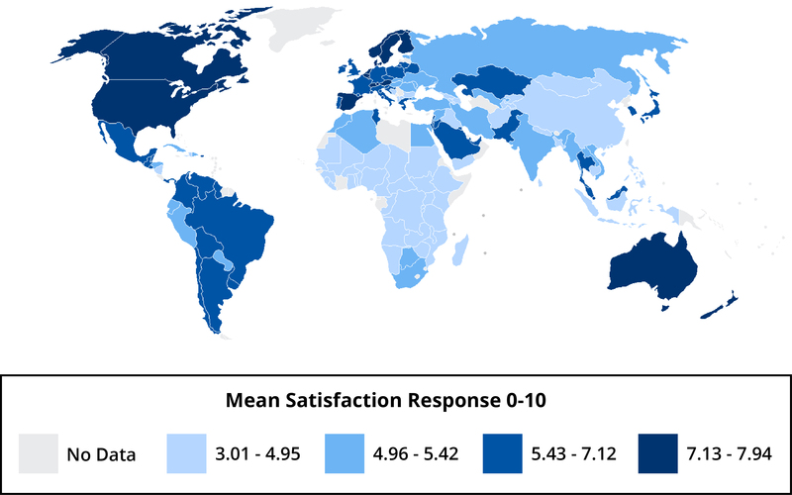
Surveys
Notes:
Surveys are popular research tools for social scientists. They are used for political polling, customer satisfaction, and social psychology purposes. They are useful because they:
-- are scalable (many people can take them quickly),
-- are relatively inexpensive,
--can provide a basis for numerical comparison.
Disadvantages include:
-- the possibility of response bias (eg. Socially desirable responding)
-- non-representative sampling
-- only captures a single point in time
You might ask students about their own experience with surveys.
The image on the slide is the results from the Gallup World Poll (GWP). This map shows mean evaluations of life satisfaction (rate your life in the context of the best possible life you can imagine). This is a proxy measure for life satisfaction and the darker the green the more satisfied people are, on average. The darker the red the less satisfied they are. The GWP includes a minimum of 1000 demographically representative people (urban/rural, religion, education, gender, etc) for each nation. Some nations had more (eg. China had more than 38 thousand respondents). The data was collected either by phone (random digit dialing in economically developed nations) or face to face door-to-door interviews (less developed nations). Nations in gray were not included in the study.
You can engage students in their own reactions:
1) What advantages does the GWP have? What limitations might it have?
2) What might you conclude about happiness based on this map? (NOTE: these are average scores, they do not indicate that ALL people in a given nation are satisfied or dissatisfied. You will note that western economically developed countries tend to be happier– this may not reflect an emphasis on money but may reflect the fact that these nations have lower unemployment, better social safety nets, lower indices of corruption, and are less likely to suffer armed conflict. There are some notable exceptions such as the relatively high happiness in Latin America).

Slide 12

Non-conscious Research
Fill in the blanks:
C O F F _ _
M I L _
T O A _ _
F R U _ _ _
Notes:
Researchers often use non-conscious research methods to study stereotypes, automatic processes, and issues where socially desirable responding might be an issue. Not everyone wants to admit to harboring unpopular views of groups (eg. The elderly) or of their own behavior (eg. Petty theft) so these methods can be used to side step such social desirability.
1. Priming Activity: Begin by having students fill out the words as prompted on the screen. It is likely, given the picture of breakfast, that they will be “primed” to think of breakfast related words such as coffee, milk, toast, and fruits. But other words are possible such as coffin, mile, toads, and frumpy (or frugal, for that matter). Once a concept is primed it can be temporarily difficult to break out of that particular schema. Researchers often use word-search puzzles or reflection prompts to activate schemas and stereotypes, thereby making certain information more salient. They then proceed to see what effect these primes have on thinking, feeling and behavior.
2. Implicit attitudes: The IAT uses a computer to measure reaction times of less than one second. The paradigm works by prompting participants with words or images (egs. “women” “elderly” “Christians”) and then has them quickly tap one or the other of two keys to make a snap judgment about the prompt. These judgments might be as simple as “good/bad” or “like me/not like me.” People will slow ever so slightly as they have to consider in greater depth. For example, a professional photographer might very quickly list “artist” as “like me” because she often thinks along those lines. But she might be slower when considering prompts that are not as salient or require quick processing to determine what is socially acceptable such as “liar.”

Slide 13

Archival Research
Notes:
Archival research uses published sources such as historical records or social media posts to investigate social phenomena. This has the advantage of being ecologically valid (it actually did happen in the real world) and can span long periods of time (researchers could examine records from centuries ago). To bring this to light in an engaging way you may choose to describe the Facebook study (also described in the module, excerpt below):
Researchers at Facebook attempted to test whether emotional contagion—the transfer of emotional states from one person to another—would occur if Facebook manipulated the content that showed up in its users’ News Feed. When friends’ posts with positive expressions were concealed, users wrote slightly fewer positive posts. Conversely, when posts with negative expressions were hidden, users wrote slightly fewer negative posts.
The controversial part of this study—which included 689,003 Facebook users and involved the analysis of over 3 million posts made over just one week—was the fact that Facebook did not explicitly request permission from users to participate. Instead, Facebook relied on the fine print in their data-use policy. Although researchers who collaborated with Facebook on this study applied for ethical approval from their institutional review board (IRB), they apparently only did so after data collection was complete.
Possible Discussion Questions:
What is your reaction to this study?
Do you believe the study was ethical? Why or why not? (students may point out potential conflict of interest for profit driven company to be socially manipulating its users and calling it research, no informed consent, no ethics approval received in advance).
How is this study different from other archival studies such as gathering data from diary entries of people who lived 100 years ago? (students should point out the potential for harm of living research participants)

Slide 14

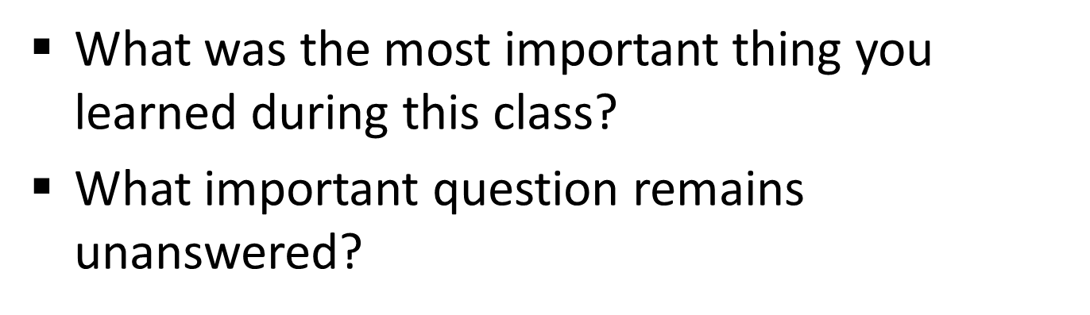
CAT: One-Minute Paper
Notes:
Classroom Assessment Technique (CAT): One-Minute Paper
If you are presenting the information on one class day, you might end the material about here. End your class time with a one-minute paper.
The Minute Paper tests how students are gaining knowledge, or not. The instructor ends class by asking students to write a brief response to the following questions: “What was the most important thing you learned during this class?” and “What important question remains unanswered?”
Have students briefly answer these questions in writing and turn them in. After class, assess students’ responses. At the beginning of the next class, go over any misunderstandings or relevant questions.
If you do not conclude with this Classroom Assessment Technique (CAT), it would helpful to use another CAT. It could be in the form of a:
Muddy point
One-minute paper
Background knowledge
What’s the Principle?
Defining features Matrix:
For more information on CATs click here: http://cft.vanderbilt.edu/guides-sub-pages/cats/

Slide 15
Photo Attribution
Slide 1 | Photo Credit: Farmers watch themselves speak to the world International Maize and Wheat Improvement Center https://www.flickr.com/photos/44760652@N05/6195475718/ https://creativecommons.org/licenses/by-nc-sa/2.0/
Slide 3 | Photo Credit: Lark Tavern before the Fire - Albany, NY - 10, May - 10 Sébastien Barré https://www.flickr.com/photos/99706198@N00/4584659751/ https://creativecommons.org/licenses/by-nc-sa/2.0/
Slide 5 | Photo Credit: Magnifying glass geralt https://pixabay.com/en/magnifying-glass-human-head-faces-1607208/ https://creativecommons.org/publicdomain/zero/1.0/deed.en
Slide 7 | Photo Credit: 2013 09 26 COE orientation 597 uoeducation https://www.flickr.com/photos/90756502@N05/10745091216/ https://creativecommons.org/licenses/by-nc/2.0/
Slide 9 | Photo Credit: Students Meeting The University of the South https://www.flickr.com/photos/sewanee/3210250742 https://creativecommons.org/licenses/by-nc-sa/2.0/
Slide 10 | Chart Credit: Created using information from: Isen, A. M., & Levin, P. F. (1972). Effect of feeling good on helping: Cookies and kindness. Journal of Personality and Social Psychology, 21(3), 384-388.
Slide 11 | Image Credit: Mean Life Satisfaction by Country. Noba Project. https://creativecommons.org/licenses/by-nc-sa/4.0/deed.en_US
Slide 12 | Photo Credit: 7-30am Stefano https://www.flickr.com/photos/78173355@N06/17558417656/ https://creativecommons.org/licenses/by-nc-nd/2.0/
Slide 13 | Photo Credit: Facebook bykst https://pixabay.com/en/facebook-social-networking-networks-257829/ https://creativecommons.org/publicdomain/zero/1.0/deed.en
Slide 14 | Photo Credit: Photo Credit: Illustrated silhouette of a black cat nehtaeh79 http://www.freestockphotos.biz/stockphoto/16624 http://creativecommons.org/publicdomain/zero/1.0/
Notes:
Photo Attribution Slide

